Slide 1

Welcome to Spring 3.0 Chapter 3 – Spring MVC

Slide 2
Chapter 2 – Spring MVC
Spring MVC | Architecture DispatcherServlet
 | Request/Response Lifecycle Spring MVC Details
 | Handler Mappings Controllers View Resolvers
 | Tags Validation Message Bundle
 | Integration of Spring with Struts

Slide 3





Bank Branch Use Case
1. Customer reaches the building where the bank’s branch is located.
2. Enters branch’s gate(security guard, metal detector, camera,
signs a register etc.).
3.Reaches “Help” counter. Staff A redirects to specific counter
/section/desk.
4.Counter Staff B takes your form(say withdraw large cash, security
device or statement request) and completes the process and
forwards to next counter/section with an advice slip for token
handover, cash or prints.
5.This counter staff C prints your acknowledgement or statements
and hands over cash or device etc. depending on the request.
6. Your task is complete, you go out of the branch gate by signing
the register with “out time” and then finally out of the building!

Slide 4
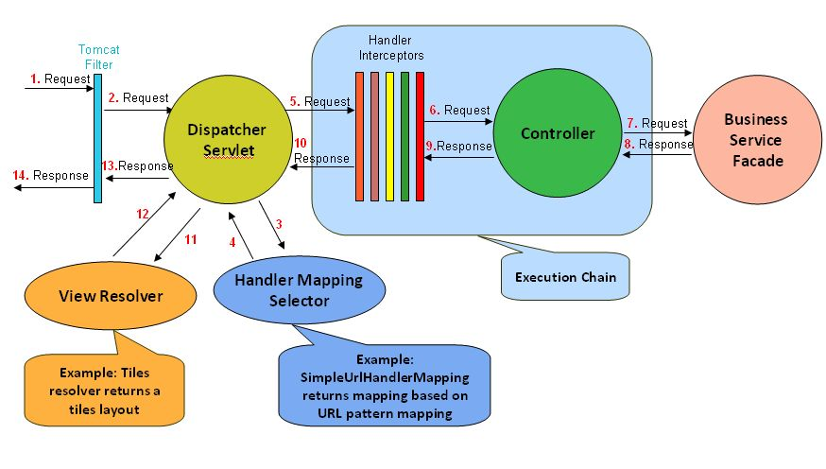
Architecture

Slide 5
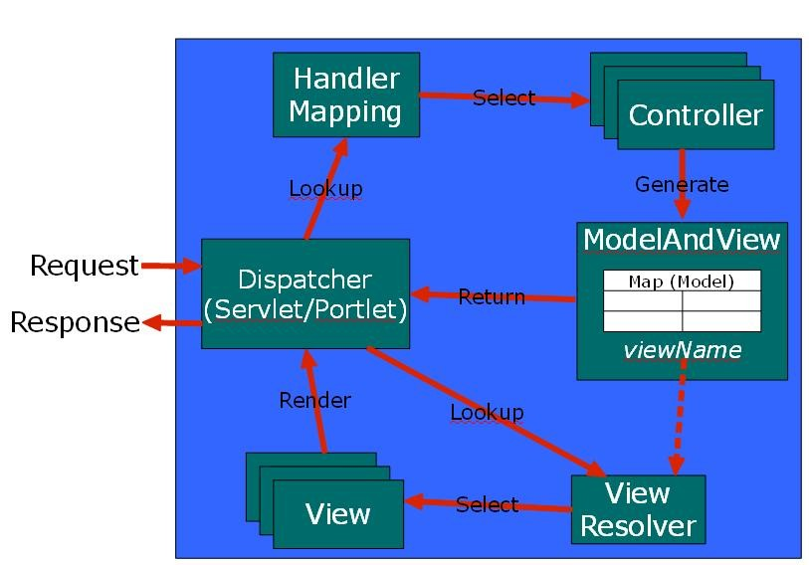
Control Flow
Notes:
http://www.javabeat.net/2007/06/introduction-to-spring-mvc-web-framework-web-tier/

Slide 6
MVC
Separate the Data Access, Business Logic and Presentation using a M.V.C. Framework
Model:
The class org.springframework.ui.ModelMap is used by the spring framework to hold the data. It wraps the business data into org.springframework.ui.ModelMap class and then pass it to the view.
View:
Framework provides pluggable view, and it allows the developers to create views using jsp, Velocity , Jasper templates etc. In Spring MVC Logical view and Model are represented in the object of the class org.springframework.web.servlet.ModelAndView.
SpringMVC1
SpringMVC2
SpringMVC3-Form
SpringMVC3-FormValidate
SpringMVC3-FormValidate2
SpringMVC3-FormValidate-XML-Logon
Controller:
The controller is responsible for handling all the requests from the user and then process the user request.
org.springframework.web.servlet.mvc.Controller
Notes:
http://www.javabeat.net/2007/06/introduction-to-spring-mvc-web-framework-web-tier/
http://localhost:8080/SpringMVC/welcome.htm is requested.
URL has “.htm” extension, so it will redirect to “DispatcherServlet”
and send request to the default BeanNameUrlHandlerMapping.
BeanNameUrlHandlerMapping returns HelloWorldController to the DispatcherServlet.
DispatcherServlet forward requests to the HelloWorldController.
HelloWorldController processes it and returns a ModelAndView object named “HelloWorldPage”.
DispatcherServlet receives the ModelAndView and calls the viewResolver to process it.
viewResolver returns the “/WEB-INF/pages/HelloWorldPage.jsp” back to the DispatcherServlet.
DispatcherServlet return the “HelloWorldPage.jsp” back to user.

Slide 7
Validation & RefData
Spring features a Validator interface that you can use to validate objects. The Validator interface works using an Errors object so that while validating, validators can report validation failures to the Errors object.
Spring MVC, there are 3 different ways to perform validation :
Using annotation(JSR303,JSR 349)
Manually
A mix of both.
referenceData(HttpServletRequest request) & @ModelAttribute/@valid

Slide 8
Handler Mappings
BeanNameUrl HandlerMapping : maps incoming HTTP requests to names of beans, defined in the web application context
ControllerClassName HandlerMapping : simple convention for generating URL path mappings from the class names of registered Controller beans as well as @Controller annotated beans
SimpleUrl HandlerMapping : : Maps from URLs to request handler beans . Mappings to bean names can be set via the "mappings" property, in a form accepted by the java.util.Properties class
HandlerInterceptor : add common pre/post processing behaviour without needing to modify each handler implementation.
Multiple DispatcherServlet
SpringMVC5-HandlerMappings
Notes:
http://www.javabeat.net/2007/06/introduction-to-spring-mvc-web-framework-web-tier/

Slide 9
Handler Mappings
http://docs.spring.io/spring/docs/3.0.x/javadoc-api/org/springframework/web/servlet/HandlerMapping.html
http://docs.spring.io/spring/docs/3.0.0.M3/reference/html/ch16s04.html
SpringMVC5-HandlerMappings
Notes:
http://www.javabeat.net/2007/06/introduction-to-spring-mvc-web-framework-web-tier/

Slide 10
Controllers
SimpleFormController (Spring provides SimpleFromController for control a form data in the web application. If you want to handle form in spring then you need to use SimpleFormController by extending these in your Controller class. It's provides formView, successView in the case of valid submission and provide validation errors if wrong data entry by the user in the form data. This is also handle model object for binding and fetching data.)
MultiActionController(InternalPathMethodNameResolver, PropertiesMethodNameResolver, ParameterMethodNameResolver)
MultiActionController class provides us a functionality that allow to bind the multiple request-handling methods in a single controller
ParameterizableViewController : This controller doesn't require controller class. This controller provides an alternative to sending a request straight to a view such as a JSP.
AbstractController: The AbstractController provides basic features such as the generation of caching headers and the enabling or disabling of supported methods (GET/POST).
ServletForwardingController :Useful to invoke an existing servlet via Spring's dispatching infrastructure, for example to apply Spring HandlerInterceptors to its requests.
ServletWrappingController : Struts intg : Spring Controller implementation that wraps a servlet instance which it manages internally. Such a wrapped servlet is not known outside of this controller; its entire lifecycle is covered here (in contrast to ServletForwardingController).
UrlFilenameViewController : Simple Controller implementation that transforms the virtual path of a URL into a view name and returns that view.
AbstractCommandController CancellableFormController AbstractWizardFormController
BaseCommandController AbstractFormController
SpringMVC6-Controllers
Notes:
http://www.javabeat.net/2007/06/introduction-to-spring-mvc-web-framework-web-tier/

Slide 11
Controllers
http://docs.spring.io/spring/docs/3.0.x/javadoc-api/org/springframework/web/portlet/mvc/Controller.html
http://docs.spring.io/spring/docs/3.0.0.M3/reference/html/ch16s03.html
Notes:
http://www.javabeat.net/2007/06/introduction-to-spring-mvc-web-framework-web-tier/

Slide 12
View Resolvers
InternalResourceViewResolver
UrlBasedViewResolver
XmlViewResolver
ResourceBundleViewResolver
AbstractPdfView
Chaining/ordering ViewResolvers
Redirect -> RedirectView vs redirect: vs forward:
SpringMVC7-ViewResolver
Notes:
http://www.javabeat.net/2007/06/introduction-to-spring-mvc-web-framework-web-tier/

Slide 13
View Resolvers
http://docs.spring.io/spring/docs/3.0.0.M3/reference/html/ch17.html
http://docs.spring.io/spring/docs/3.0.0.M3/reference/html/ch16s05.html
http://docs.spring.io/spring/docs/3.0.x/javadoc-api/org/springframework/web/servlet/View.html
http://docs.spring.io/spring/docs/3.0.x/javadoc-api/org/springframework/web/servlet/ViewResolver.html
SpringMVC7-ViewResolver
Notes:
http://www.javabeat.net/2007/06/introduction-to-spring-mvc-web-framework-web-tier/

Slide 14
Type Conversion
Spring's DataBinder and the lower-level BeanWrapper both use PropertyEditors to parse and format property values. The PropertyEditor concept is part of the JavaBeans specification, and is also explained in this chapter. Spring 3 introduces a "core.convert" package that provides a general type conversion facility, as well as a higher-level "format" package for formatting UI field values

Slide 15
Data Binding
Data binding is useful for allowing user input to be dynamically bound to the domain model of an application (or whatever objects you use to process user input). Spring provides the so-called DataBinder to do exactly that. The Validator and the DataBinder make up the validation package, which is primarily used in but not limited to the MVC framework.

Slide 16
Exception handling
http://www.tutorialspoint.com/spring/spring_exception_handling_example.htm

Slide 17
Spring taglib
Spring message bundle
Integration of Spring with Struts

